Slide 1
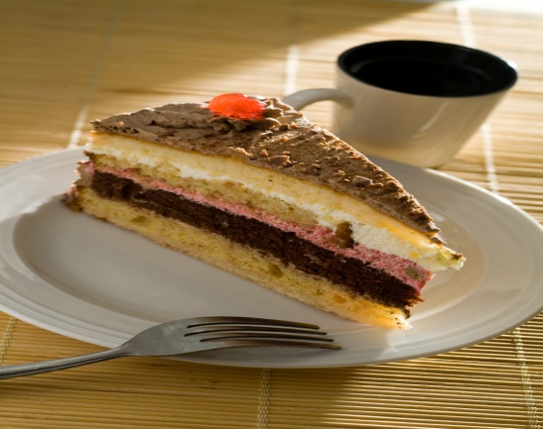
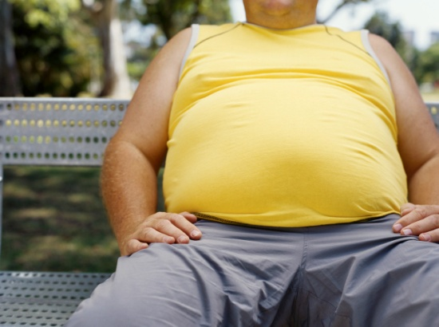
Lack of Physical Activity and Unhealthy Food Choices =
OBESITY

Slide 2
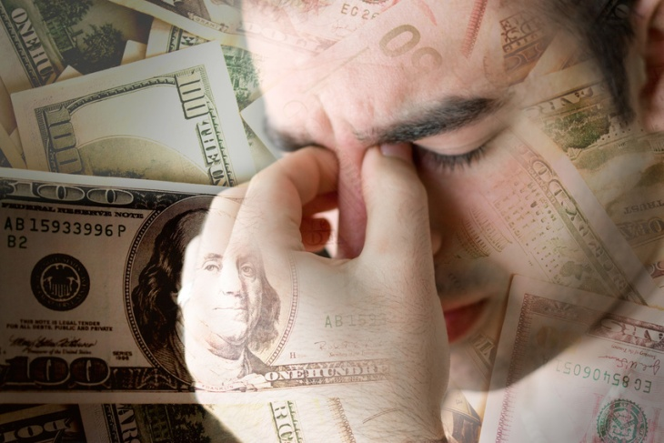
The Scary Reality Is.....
One in five children and adolescents are either overweight or obese.
From 1985 to 1995 the number of overweight 7–15 year olds almost doubled.
The numbers of obese children has more than tripled.
About 80 per cent of obese adolescents will become obese adults.
At the current rate, it is predicted that 65 per cent of young Australians will be overweight or obese by 2020.
(Website Source: http://www.betterhealth.vic.gov.au/bhcv2/bhcarticles.nsf/pages/Obesity_in_children)

Slide 3
Did you know?
Obesity is the leading cause of preventable death, next to smoking!
The number of overweight children in Australia has doubled in recent years, with a quarter of children considered overweight or obese.
(Website Source: http://www.youtube.com/watch?v=SkS2bhF-ljg)

Slide 4
What health problems associated with obesity ?
Type 2 diabetes
Eating disorders
Orthopedic disorders
Liver problems, including fatty liver
Respiratory disorders
Sleep apnea
Cardiomyopathy – a problem with the heart muscle, caused when extra effort is needed to pump blood.
(Website Source: http://www.betterhealth.vic.gov.au/bhcv2/bhcarticles.nsf/pages/Obesity_in_children)

Slide 5

So what are the causes?
Changing Society
Food Choices
Lack of Physical Activity
Family Eating Habits
(Website Source: http://www.betterhealth.vic.gov.au/bhcv2/bhcarticles.nsf/pages/Obesity_in_children)

Slide 6
Some examples include:
Cost of food has decreased.
More food is prepared away from home.
Energy-dense foods / drinks are readily available.
Portion sizes have increased.
Marketing of energy-dense foods / drinks has increased.
The use of cars has increased.
The number of two-income families has increased.
(Website Source: http://www.betterhealth.vic.gov.au/bhcv2/bhcarticles.nsf/pages/Obesity_in_children)

Slide 7
Dietary Fat Quiz
Go to this website and complete the Dietary Fat Quiz:
http://www.betterhealth.vic.gov.au/bhcv2/bhcarticles.nsf/pages/Quiz_dietary_fats?OpenDocument
How did you score?

Slide 8
Explore the Food Guide Pyramid
Click on the interactive link below and click on the pyramids colours to learn about the different food groups
http://kidshealth.org/kid/stay_healthy/food/fgp_interactive.html

Slide 9
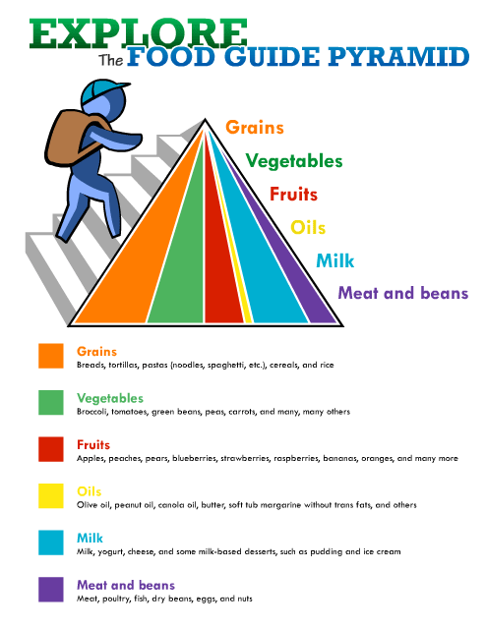
Food Pyramid
The foods you eat have been divided into three groups according to how nutritious they are. These make up what is often called the ‘food pyramid’.

Slide 10
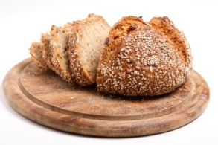
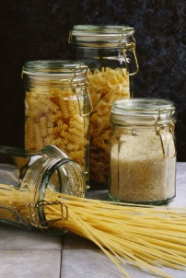
Three Food Groups
Group 1: You should try to eat lots of:
Fruits and vegetables
Breads
Grains such as rice and pasta

Slide 11
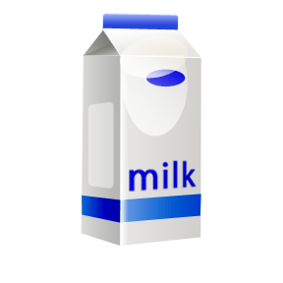
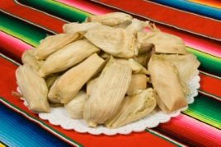
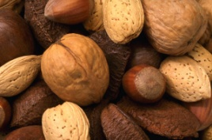
Three Food Groups
Group 2: Eat these foods moderately
Dairy products such as milk, cheeses and yoghurts
Lean meat
Chicken (without skin)
Fish
Nuts

Slide 12

Three Food Groups
Group 3: Eat these foods sometimes
Sweet biscuits (2 small)
Chocolate coated bars (1 bar)
Potato chips (30g)
Ice-cream (2 scoops)
Lollies/chocolate (30g)
Cake or muffin (1 medium piece)

Slide 13
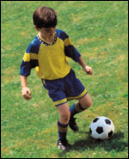
What are the benefits of Physical Activity?
Cardiovascular fitness
Healthy weight
Improved posture
Reduced blood cholesterol
Better sleep
Boosted self-esteem and confidence
Improved concentration
Reduced stress, depression and anxiety
Enhanced social skills.
(http://www.betterhealth.vic.gov.au/bhcv2/bhcarticles.nsf/pages/Children_getting_them_active?OpenDocument)

Slide 14
How to design a fitness program?
Consider your goals.
Think about your likes and dislikes. Choose activities you’ll enjoy.
Plan a logical progression of activity.
Build activity into your daily routine.
Think variety.
Allow time for recovery.
Put it on paper. A written plan may encourage you to stay on track.

Slide 15
Getting Started
Start slowly and build up gradually.
Break things up if you have to.
Be creative. Include other activities such as walking, bicycling, rowing or dancing in your routine.
Listen to your body. Don’t push yourself too hard.
Be flexible. If you’re not feeling good, give yourself permission to take a day or two off.

Slide 16
Monitor your progress
Assess your progress at six weeks after you start your program and then again every three to six months.
You may need to increase the amount of time you exercise in order to continue improving.
If you lose motivation, set new goals or try a new activity.
Exercising with a friend or taking a class at a local fitness centre may help.

Slide 17
TV Commercials…lets look at some
Childhood Obesity Prevention Featuring Shrek:
http://www.youtube.com/watch?v=r-zEDbl04NY
Childhood Obesity Commercial
http://www.youtube.com/watch?v=SkS2bhF-ljg
Obesity Commercial:
http://www.youtube.com/watch?v=tMLumVfhWfs

Slide 18
Your Reflections
What did you think of these commercials?
How did they make you feel?
What actions can you take to prevent obesity?

Slide 19

Your Mission
IN GROUPS OF 4-5:
Design a healthy eating program.
Design an exercise program.
Monitor your progress for 6 weeks by keeping an online journal and write a reflection to your Blog outlining your progress.
Present this to the class as a PowerPoint Presentation.

Slide 20

Remember
Being fit is a way of saying a person eats well, gets a lot of physical activity exercise, and has a healthy weight.
If you're fit, your body works well, feels good, and can do all the things you want to do, like run around with your friends.

